Slide 1
Getting Started with Power BI Desktop
Notes:
This module introduces students to Power BI Desktop and provides a high-level overview of managing the lifecycle of a Power BI Desktop project. Students will learn how the contents of a Power BI Desktop project are saved and published using the PBIX project file format. The module demonstrates how to import data from an external source into a Power BI Desktop project to create a dataset. Students will also learn how to get started with data modeling by creating simple calculated columns and measures. Students will also get hands-on experience using the report designer in Power BI Desktop and publishing a PBIX project file to the Power BI service to make a Power BI Desktop report accessible through the browser.

Slide 2
Student Background
What is your name?
What are you doing with Power BI?
Which products have you used
Access
Excel
SQL Server, SSRS, SSAS
Others

Slide 3
Agenda
What Is Power BI?
Getting Started with Power BI Desktop
Creating Queries in Power BI Desktop
Modeling Data in Power BI Desktop
Designing Reports in Power BI Desktop

Slide 4
What is Power BI?
What is Power BI?
Cloud-based subscription service
Environment which promotes self-service BI to the end user
BI Platform to assists with data import, analysis and visualization
Power BI benefits from being a cloud-based service
It takes only 5 seconds to subscribe to the Power BI service
New users can create something significant in 5 minutes or less
Power BI adoption numbers (as of Q1 2016)
5 million subscribers
200,000 organizations
40 different languages
Notes:
Power BI is a cloud-based subscription service from which provides business users with an environment participate in self-service BI. For ad-hoc scenarios is provides an end user with a straight-forward manner to import and analyze and to visualize insights from that data. To system integrators and data professionals, Power BI represents a platform for creating business solutions that assists with data analysis and insight visualization.
Because Power BI benefits is a cloud-based service, a new user can subscribe in under a minute. Another important goal of the Power BI team at Microsoft was to remove dependencies so that new users can quickly begin importing data and creating visuals using nothing more than the browser.
As of March 2016, the Power BI service has experience strong adoption numbers. The Power BI service has surpassed 5 million subscribers who come from over 200,000 different organizations. The Power BI service subscribers come from many different countries and take advantage of the fact that the Power BI service has been localized for over 40 different languages.

Slide 5
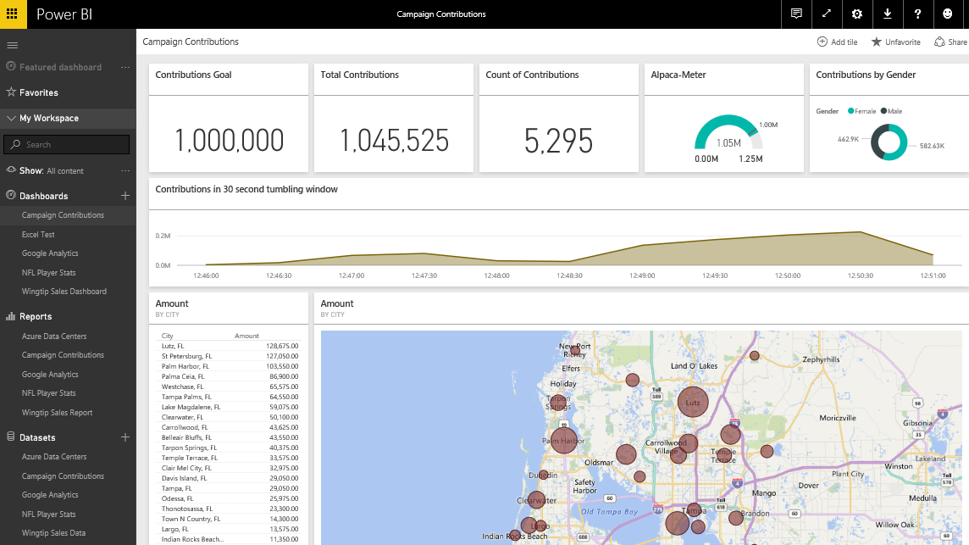
The Power BI Service
The Power BI Service
Provides cloud-based foundation for Power BI platform
Accessible through browser at https://app.powerbi.com
Notes:
You can think of the Power BI service as the heart and sole of the Power BI platform. Subscribed users access the Power BI service using any modern browser through its primary URL which is https://app.powerbi.com. Once a user has been authenticated against the common endpoint of https://app.powerbi.com, the users is then connected to the Azure data center which hosts the user’s Power BI workspaces.
Using the browser, a Power BI subscriber can view dashboard and interactive reports. The browser-based experience of the Power BI service also provides support to import datasets and to create reports and dashboards.

Slide 6
Agenda
What Is Power BI?
Getting Started with Power BI Desktop
Creating Queries in Power BI Desktop
Modeling Data in Power BI Desktop
Designing Reports in Power BI Desktop

Slide 7
Project Lifecycle for a Custom BI Solution
Lifecycle of a typical BI project includes...
Discover where the data lives
Extract, transform and load (ETL) data
Model data to create dataset for analytics and reporting
Design and implement reports on top of dataset
Consolidate reports into one or more dashboards
Package project artifacts for deployment
Deploy to production environment
Typical BI Project Lifecycle
Data Discovery
ETL
Data Modeling
Design Reports
Design Dashboards
Deploy Dashboards
Notes:
For decades, people in the IT industry have been working on projects to support various forms of business intelligence. Regardless of the toolset being used, a project to create a custom BI solution typically follows a standard lifecycle moving from one phase to the next.
The first phase requires figuring out what you want to measure and then moving on to discover what data exists to support making these measurements. Next, you must work through the ETL phase where the data is extracted, transformed and loaded into some type of data model. In next phase, you engage in data modeling using something such as the multidimensional model or the tabular model to make the data better suited for data analysis and reporting.
Once you have designed a data model, the next step involves designing reports to display numeric figures and visual elements on the computer screen and/or the printed page. Depending on the tools you are using, reports might be complimented by the creation of dashboards or scorecards which are designed to provide a consolidated overview and key insights using visuals elements such as key performance indicators (KPIs).
The final step involves deploying all the work you have done into a production environment so that business users can begin using what you have built in the course of their daily work. This phase typically involves packaging reports and dashboards and using some type of distribution mechanism to make your custom solution available to the general user population.

Slide 8
Working with Power BI Desktop
Power BI Desktop focuses on first four phases
Query features for Data Discovery
Query features for ETL
Design features and DAX language for data modeling
Report design using a visual report designer
No support for designing dashboards
No support for packaging an entire solution
Assistance from Power BI Desktop
Data Discovery
ELT
Data Modeling
Design Reports
Design Dashboards
Deploy Dashboards
Notes:
Power BI Desktop doesn’t do everything. Instead, it focuses on the first four phases of creating a custom BI solution.
When you begin a project in the data discovery phase, Power BI Desktop is an excellent tool to begin inspecting different forms of data and to assess how useable and useful that data might be to the project. Once you have determined what data you need to work with, the powerful and easy-to-use query features of Power BI Desktop will take you through the ETL phase. Power BI Desktop also provides a rich set of features for modeling data and designing reports.
Currently, Power BI Desktop provides no support for designing dashboards. Once you have designed a data model and a report in a local Power BI Desktop project and then you have published the project to the Power BI service, you will use a browser to complete the final steps of designing a dashboard and deploying all your work using dashboard sharing or an organizational content pack.

Slide 9
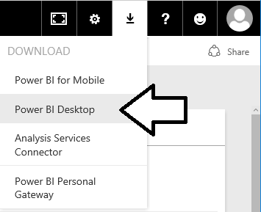
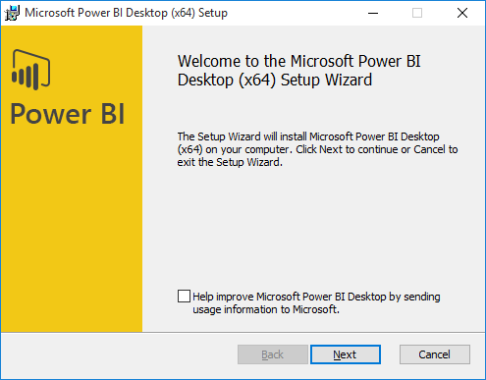
Installing Power BI Desktop
Power BI Desktop quick & easy to install over the Internet
Select Power BI Desktop option from Power BI Download menu
Power BI Desktop downloads & installs in less than a minute
Notes:
Of course, you can’t use Power BI Desktop until you installed it on a computer running Windows. Fortunately, it can be downloaded and installed in less than a minute using a standard Internet connection. Just log into the Power BI service and select the Power BI Desktop option from the Download menu to begin the download and installation process.
We recommend installing Power BI Desktop on a computer or a virtual machine running a 64-bit version of either Windows 10 or Windows Server 2016. However, it is possible to install Power BI Desktop on older 32-bit versions of Windows all the way back to Windows 7 and Windows Server 2008 R2. The main advantage of using a 64-bit version of Windows over a 32-bit version is that you can load much larger datasets into memory and you can install and test Power BI Gateways which do not support 32-bit operating systems.
Power BI Desktop is built on top of .NET Framework version 4.5 which is automatically installed with recent versions of Windows. However, older versions of Windows might require you to download and install .NET Framework version 4.5 before you will be able to install Power BI Desktop.

Slide 10
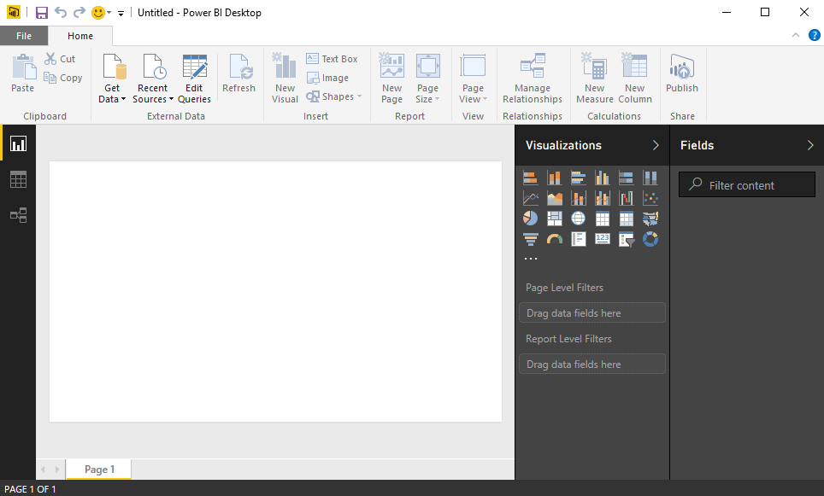
Working with Power BI Desktop
Power BI Desktop is a Windows application
Work is saved and published in terms of projects
You can work on multiple projects at once
Each project runs in its own Power BI Desktop instance
Power BI Desktop can freeze up or act buggy
Quit & restart Power BI Desktop if it acts strangely
Notes:
When you work with Power BI Desktop, all the work you do creating queries, modeling data and designing report is saved and published in terms of projects. For example, you might create one project for expense reporting and another project to create a mobile dashboard for sales analysis.
Power BI Desktop has commands to open projects and to create new project but it provides no command to close a project. For this reason, it’s easy to start up several instances of Power BI Desktop at once by mistake which can become confusing. When you are done working on a project, you should quit that instance of Power BI Desktop to keep the number of running instances of Power BI Desktop to a minimum.
Power BI Desktop is a cutting-edge Windows application. There are many parts of it that you will absolutely love. But you must keep in mind that Power BI Desktop is an application that has very short release cycles and constantly introduces new preview features. It’s not going to be as polished or as stable as some of your other favorite Windows applications.
There will likely be a time this week when you are cussing out Power BI Desktop because it’s frozen up on you after you’ve done a bunch of design work without saving your changes. Other times Power BI Desktop might prompt you with dialog boxes that don’t display correctly. If you think that Power BI Desktop is behaving strangely, save you work then shut it down and restart it. But don’t let this get you down. We would have never gotten to the moon if we were too afraid to take risks.

Slide 11
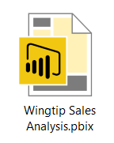
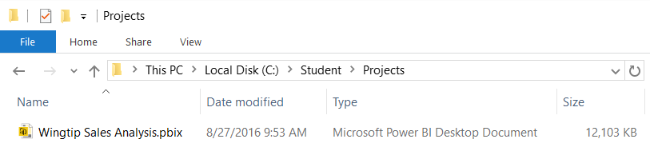
Projects and PBIX Files
Power BI Desktop projects saved using PBIX files
PBIX file contains data source definitions
PBIX file contains query definitions
PBIX file contains data imported from queries
PBIX file contains exactly one data model definition
PBIX file contains exactly one report
PBIX file never contains data source credentials
Notes:
Power BI Desktop projects are saved, loaded and published using PBIX files. A PBIX file is a ZIP archive created using the Open Packaging Convention format just like common Office documents such as DOCX files and XLSX files. The files for datasets that are stored inside and loaded from a PBIX file are managed internally by Power BI Desktop using Microsoft’s xVelocity Tabular database engine.
Each project created using Power BI Desktop is stored as a single PBIX file. Just about everything you create and configure when using Power BI Desktop is stored inside the PBIX file for one specific project. A PBIX file stores data source definitions and query definitions as well as tables of data which are populated and refreshed when queries are executed. A PBIX files also includes all the work you have done with data modeling and report design.
From a project management perspective, it’s important to understand that a PBIX file represents a single project which contains exactly one dataset and exactly one report. You cannot add a second report to a Power BI Desktop project. However, you can add as many pages as you would like to a project’s one and only report.
You should take note that Power BI Desktop will never store data source credentials in a PBIX file. For example, PBIX files never contain the user name and password required to access a secured resource such as a Online service or an on-premises SQL server database. Instead, Power BI Desktop provides the convenience of storing data source credentials in a local cache so you are not required to continually log into the same data source when working with Power BI Desktop. But these credentials are never published along with a PBIX file. After you publish a Power BI Desktop project by uploading its PBIX file, you will be required to configure data source credentials separately using the browser or by using some other automated technique.

Slide 12

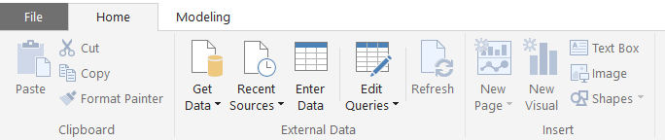
Getting Around in Power BI Desktop
What do you need to learn to use Power BI Desktop?
Query features for importing data
Design features for modeling data
Report designer for creating reports
Navigating between view modes
Report View
To access query features
Data View
Relationship View
Notes:
What do you need to learn to get up to speed on Power BI Desktop? There are three main areas to focus on at first which include creating queries, modeling data and designing reports. First, you must learn how to design queries which import data. The creation of queries is what allows you to create a base set of tables in the dataset for a Power BI Desktop project. Next, you must learn how to use the data modeling features so you can extend the project’s dataset to create a rich data model with things like calculated columns, measures and hierarchies. After that, you must learn how to use the report designer in Power BI Desktop to present the data analysis for your project using tables and visual images and to provide the user with interactive capabilities.
You will use Power BI Desktop’s main application window to model data and to design reports. The main application window provides a left navigation menu that allows you to switch back and forth between report view, data view and relationship view. When you need to create and design queries, you will do that in a separate Query Editor window which can be opened using one of the menu buttons in the ribbon of the main application window inside the External Data group on the Home tab.

Slide 13
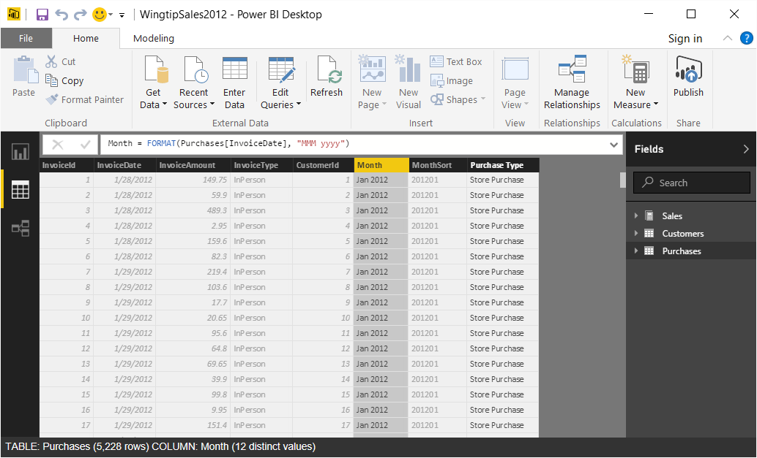
Data View
Data view is used for data modeling
Data View displays columns and rows of data for each table
Data View used to create calculated columns and measures
Notes:
Data View provides a tabular view of each table in the project’s data model. You can see the rows of data that your queries have been imported into the project’s dataset. You can navigate from table to table using the Fields list displayed on the right side of the main application window. When you need to select a column to modify one of its properties in the ribbon, you can select a column by clicking on it in the Fields list or by clicking on its column header in the tabular view of the data.
Data view is useful for examining rows of data and for modifying column properties such as a data type and formatting. It is also frequently used to created calculated columns and measures. Data view is the preferred view for writing the DAX expressions for calculated columns because you can see and reference the other columns in the same table.

Slide 14
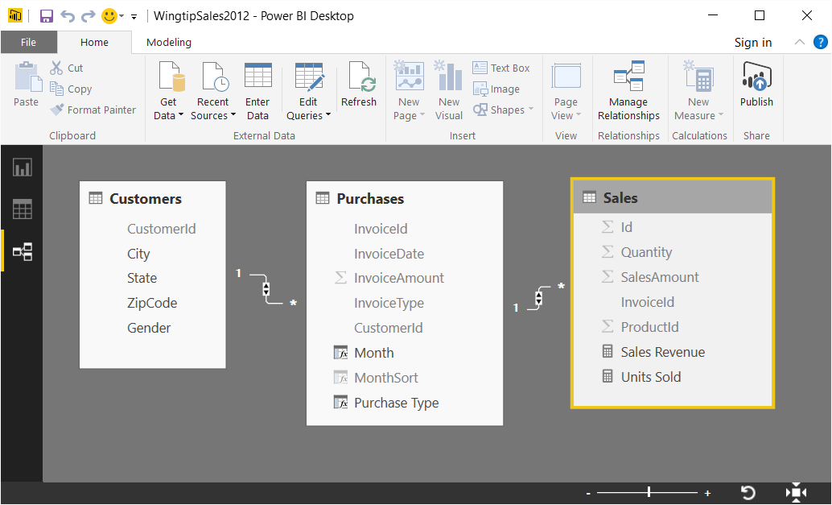
Relationship View
Displays tables, fields and relationships
Used to view tables, fields and relationships in project's dataset
Used to create relationships when importing new tables
Notes:
Relationship view shows all the tables in the current project’s dataset as well as the relationships that exist between these tables. As its name implies, Relationship View can be used to create, view, modify and delete the relationships that exist between tables. However, Relationship View is useful for far more than this.
Relationship View allows you to visualize the data model for a Power BI Desktop project . Relationship View allows you to quickly see how each table has been designed as a collection of Fields which can include native columns, calculated columns and measures. Relationship View will also allow you to view (but not created) dimensional hierarchies if they exist.
Relationship View can also be useful for quick changes to the Fields in the project’s dataset. If you locate a field in Relationship View and right-click it, you can select then from a set of commands for renaming the field, deleting the field and hiding the field from Report View.

Slide 15
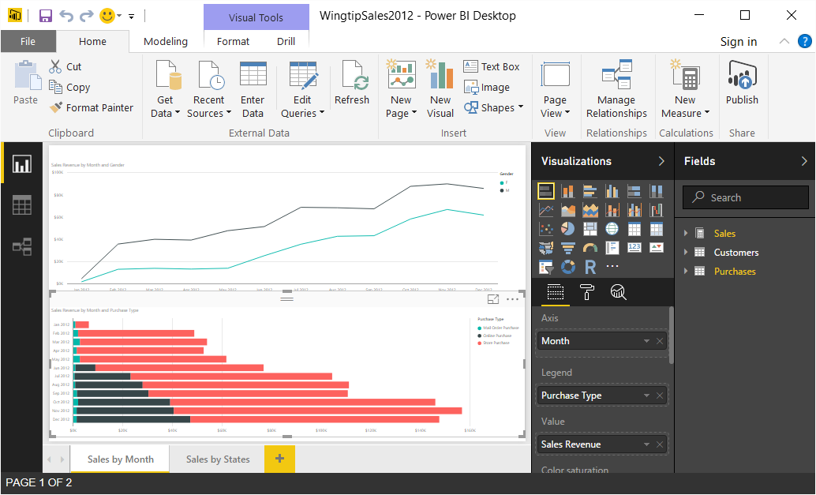
Report View
Report view used to design report for current project
Report designer is very similar to Power BI service
Dataset can be simplified for Report View by hiding fields
Notes:
The first time you work in Report View in Power BI Desktop to design a report, you will get the feeling it’s very similar to designing reports when using a browser in the Power BI service. The report design experience in Power BI Desktop is similar to the browser experience because both are based on a common base of HTML5 code and client-side JavaScript. Power BI Desktop loads and initializes a session of the Internet Explorer for Report View so that it can provide you with an HTML-driven user experience in a desktop windows application.
Report View is where you design reports. Report design typically involves adding visuals to the pages of a report and then configuring the properties of those visuals. Once you get comfortable with the basics, you will want to interactive elements to users can drill down in greater detail. Remember that each project has one and only one report. In a new project, this report initially contains a single page named Page1. However, you can additional pages. You can (and should) rename each page so that the names of pages in a report are intuitive for all that view it.
When you are in Reports View, you will see the Fields list on the right-hand side of the main application window. The Fields list is an essential design element in report design when you configuring the data properties for a visual using the Fields pane. However, you might not see as many fields as you will see when you are in Data View or Relationship View. That’s because it is a common practice to hide fields from report view. That allows you to simplify the view of the project’s data model when designing reports.

Slide 16
Getting Up and Running with Power BI Desktop

Slide 17
Agenda
What Is Power BI?
Getting Started with Power BI Desktop
Creating Queries in Power BI Desktop
Modeling Data in Power BI Desktop
Designing Reports in Power BI Desktop

Slide 18
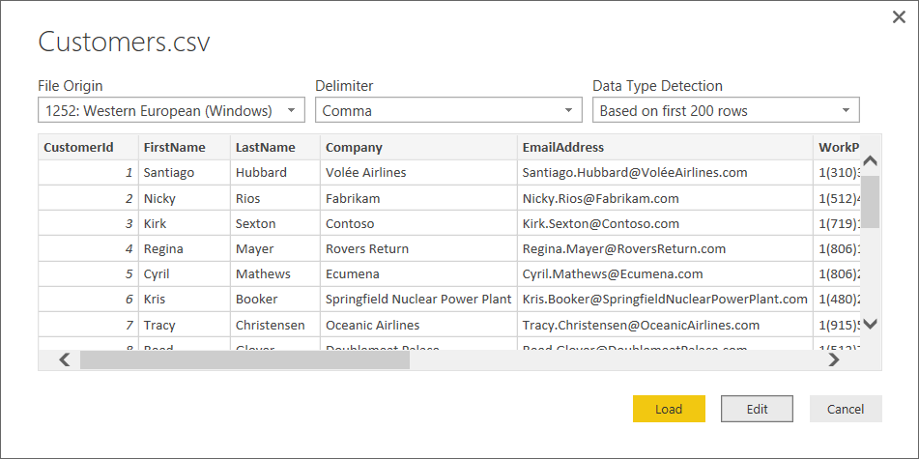
Creating Queries
Power BI Desktop provides powerful query features
Get started by creating a new query
The difference between Load versus Edit
Load command creates and execute new query without editing query
Edit command creates new query & opens it in Query Editor window
To create a new query
Notes:
The first thing you need to do when starting a new Power BI Desktop project is to create one or more queries to generate one or more tables by importing data into the dataset for your new project. In the upcoming lab exercise for this module you will create three queries from three separate CSV files that contains sales data. When you execute these queries, they will import data into your project’s dataset to generate a set of three tables.
When you create a new query in Power BI Desktop, you are often given a choice between the Load command and the Edit command. There is a significant difference between the two. The Load command simply creates a new query and executes it immediately to load the data for a new table in your project. When you create a new query with the Load command, the new query is created to import all the columns in the underlying data source and you are not provided with any opportunity to modify the query to transform data during the import process. The Edit command creates a new query but does not execute it. Instead, it opens the new query in the Query Editor window giving you the opportunity to select which columns you want to import and to further design the query’s cleanup and transform behavior before you execute the query for the first time.

Slide 19
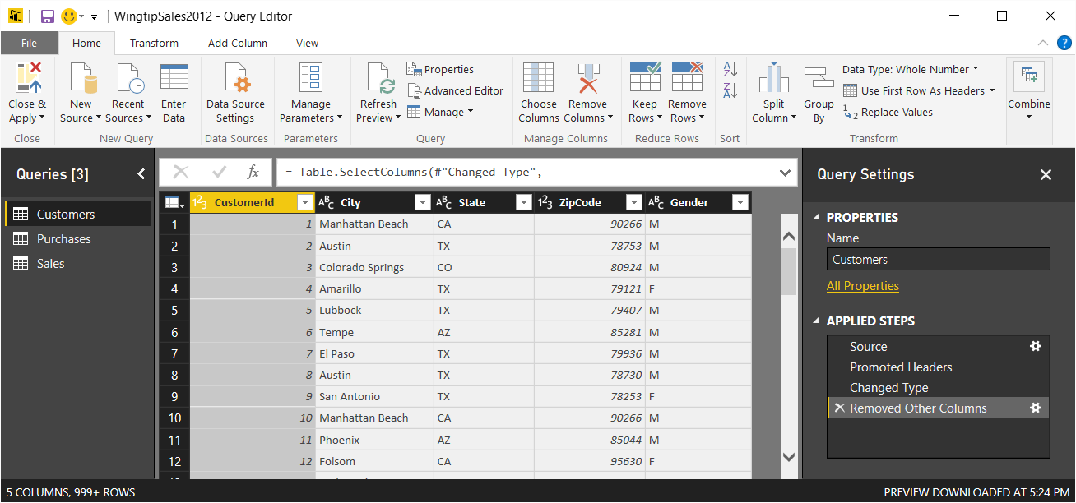
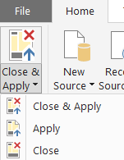
Query Editor Window
Power BI Desktop provides separate Query Editor window
Provides powerful features for designing queries
Displays list of all queries in project on the left
Displays Properties and Applied Steps for selected query on right
Preview of table generated by query output shown in the middle
Query can be executed using Apply or Close & Apply command
Notes:
In Power BI Desktop, do not design queries in the main application window. Instead, you edit queries using a separate Query Editor window. That means you must become comfortable moving back and forth between the main application window and the Query Editor window. You can open the Query Editor window using one of the menu buttons in the ribbon of the main application window inside the External Data group on the Home tab.
You design queries by executing commands on columns in the Query Editor window and working with the commands available in the ribbon. The Query Editor window displays a list of all queries in project on the left making it possible to select the query you want to work on. The Query Editor window displays the Properties section and the Applied Steps section for selected query on right. In the middle of the screen, the Query Editor window displays a preview of the table that will be generated by the query’s output.
When you are done designing queries, you often need to execute them to import data into your project to create a base set of tables. You can execute the queries you have been editing by running either the Apply command or the Close & Apply command from the Home tab in the ribbon. The difference between these commands is that the Apply command executes queries while leaving the Query Editor window open while the Close & Apply command execute the queries and then closes the Query Editor window.

Slide 20
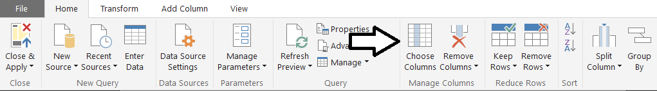
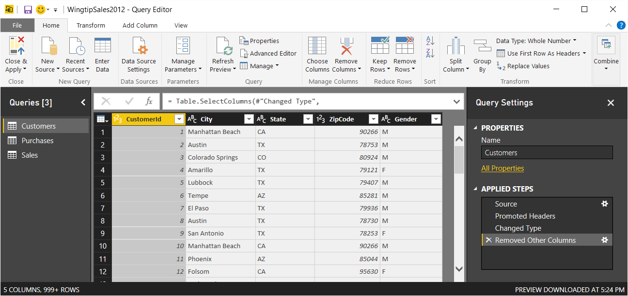
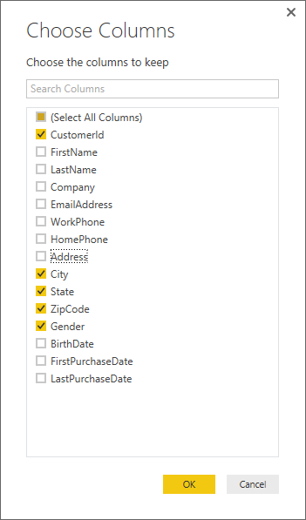
Queries Are Defined as Sequence of Steps
Here is an example of adding a query step
Click a column header then click Choose Column button in ribbon
Query definition is modified by adding new step
Notes:
As you begin to create and design queries in Power BI Desktop, it’s essential that you see that every query is defined as a sequence of query steps. As you work with the Query Editor window, you will typically add new steps to a query at the end after all the other steps that have already been added. However, as you start getting more comfortable with the Query Editor window you will find times when you will want to insert new steps in the middle of the Applied Steps list in front of pre-existing steps.
Each time you create a new query in Power BI Desktop, you are really creating a query definition that is stored and executed using code written in a special programming language named “M”. Internally, Power BI Desktop tracks each step you add to a query using a single line of M code. For example, adding the Choose Columns query step shown in the slide above results in the following M code.
Table.SelectColumns(#"Changed Type",{"CustomerId", "City", "State", "ZipCode", "Gender"})
The training course will not go into the details of M code in this module. Instead, this course will cover how each query is stored and executed as a batch of M code in greater detail in the next lecture in Module 3 which focuses on query design in Power BI Desktop.

Slide 21
Designing Queries to Import Data

Slide 22
Agenda
What Is Power BI?
Getting Started with Power BI Desktop
Creating Queries in Power BI Desktop
Modeling Data in Power BI Desktop
Designing Reports in Power BI Desktop

Slide 23
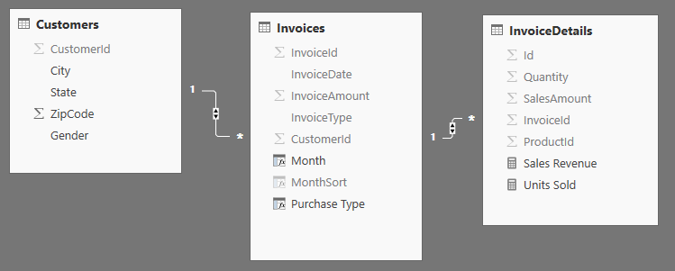
The Project's Data Model
Each PBIX project defines a data model
Data model contains tables, fields and relationships
Tables contain three different types of fields
Native columns
Calculated columns
Measures
Notes:
Each PBIX project is created with a dataset which is initially empty. As you have learned in the last section, you typically begin a Power BI Desktop project by creating a set of queries to import data which creates a base set of tables in the project’s dataset. The next step is to leverage the data modeling capabilities of Power BI Desktop to transform that base set of tables into a rich data model so that the data you have gathered in your project is better suited for data analysis and reporting.
Tables in the data model will initially contain a set of native columns that have been imported during query execution. You will often start your data modeling by modifying native columns by renaming them and setting the formatting properties for the column’s data value. You will also extend tables by adding calculated columns and measures to enrich the data model for use in report design. If you examine the screenshot in the slide above, you can see that Relationship View displays icons next to fields so you can determine what type of field each one is.
Native columns containing text-based data such as the City field and the State field have no icon next them. Native columns with numeric data such as SalesAmount and UnitsSold are displayed with the sigma (Σ) icon to indicate they support aggregate operations such calculating a sum or average. Calculated columns are displayed with a (fx) icon. Measures are display using a small calculator icon.

Slide 24
Data Analysis eXpression Language (DAX)
Calculated columns and measures created using DAX
DAX is programming language used by tabular database model
Calculated columns and measures created with DAX Expressions
DAX expressions are similar to Excel formulas
They always start with an equal sign (=)
DAX provides many built-in functions just like to Excel
DAX Expressions are not the same as Excel formulas…
DAX expressions cannot reference cells (e.g. A1 or C4)
Instead DAX expressions reference columns and tables
=SUM('Sales'[SalesAmount])
Notes:
You create both calculated columns and measures using Data Analysis eXpression Language (DAX). DAX is programming language used for data modelling with Microsoft’s tabular database model and the xVelocity database engine. DAX plays the same role for tabular databases that Multidimensional eXpressional language (MDX) plays when data modelling with multidimensional databases created for SQL Server Analysis Services (SSAS). The main difference is that DAX is much easier to use for a wider category of users. MDX has proven to be quite hard to learn and is mainly used by professional database developers. DAX was designed to be more accessible to business users engaging in self-service BI in applications such as Microsoft Excel and Power BI Desktop.
Each calculated column and measure is defined as a named, stand-alone DAX expression. When you write the DAX expression for a calculated column or measure , you begin with an equals sign which makes it similar to writing a formula for cell in an Excel worksheet. The DAX programming language also provides a large set of built-in functions similar to functions in the Excel formula language. If you are familiar writing formulas in Excel, you will find that writing expression in DAX seems very natural.
Note there is a key difference between writing formulas in Excel in cells within an Excel workbook and writing DAX expressions in Power BI Desktop. Excel formulas often reference worksheet cells using column and row addresses such as A1 or C4. However, you will never reference cells when writing a DAX expression, Instead, you write DAX expressions to reference table and columns in the data model by name.
For example, you can reference the SalesAmount column of the Sales table by writing either Sales[SalesAmount] or ‘Sales’[SalesAmount]. DAX requires you to enclose field names using square brackets. When you reference a table whose name contains one or more spaces, you must enclose the table name inside single quotes. When you reference a table whose name does not contain spaces, the use of single quotes is optional.

Slide 25
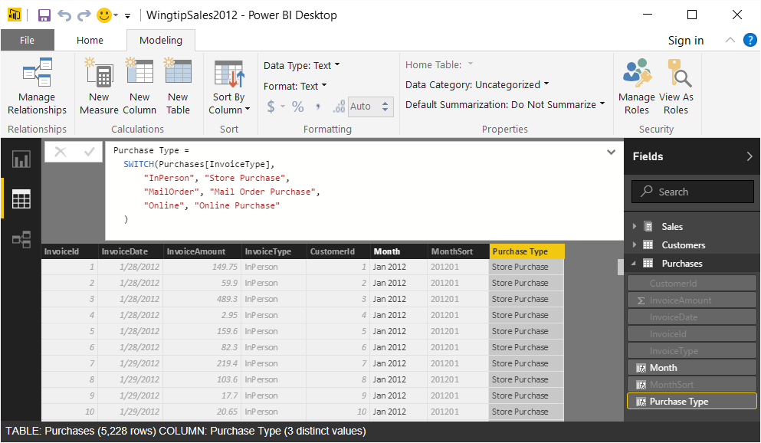
Creating Calculated Columns
Calculated column can be added to table
Calculated column created by clicking New Column button
Calculated column created as named DAX expression
DAX expression for calculate column evaluated at table load time
Notes:
A calculated column can be added to any table inside the project’s data model using Data View. Start by selecting the target table in the Fields list on the right-hand side of the Data View window. Next, click the New Column button in the ribbon to add a new calculated column to that table. After you click the New Column button to create a new calculated column, you will then edit the DAX code inside the formula bar to give the column a name and to write a DAX expression to so that the calculated column can evaluate to a value for each and every row in the table in which it resides.
The screenshot in the slide above shows an example of creating a new calculated column in the Invoices table named Purchase Type. When the Invoices table is loaded into memory, the xVelocity database engine uses the DAX expression for Purchase Type to calculate a separate value for each row in the table. There is a key point here. The DAX code you write for a calculated column expression will often reference one or more other columns from the table in which it resides. For example, the DAX code inside the expression for Purchase Type references a native column named InvoiceType to generate new value that is more user-friendly for use in reports when configuring labels and legends for a visual.

Slide 26
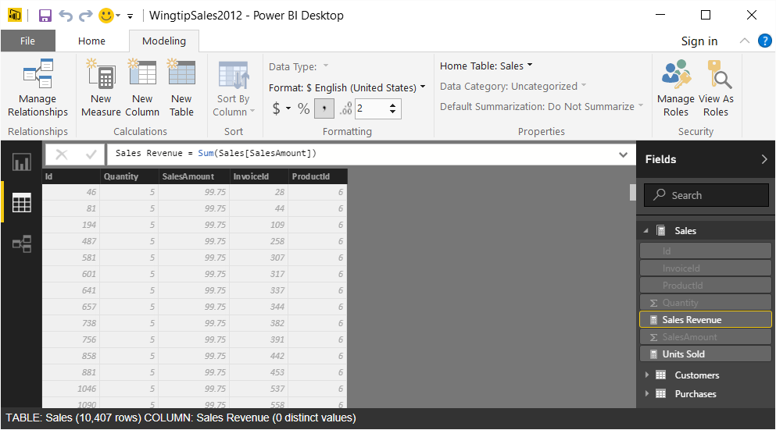
Creating Measures
Measure defined as named DAX expression
Measure created by clicking New Measure button in ribbon
Measure expression is evaluated at query time
Notes:
You can create a new measure by clicking the New Measure button in the Modeling tab in the ribbon. Like calculated columns, each measure is defined as a DAX expression with a name. However, from a design perspective you must understand that measures are quite different than calculated columns. Measures are unlike calculated columns because they are not evaluated at table load time. Instead, a measure is evaluated at query time whenever it is used in a report visual or a dashboard tile.
Think about a scenario where you have added a slicer visual to a report which allows the user to select criteria to filter the data displayed in a report. When a user selects new criteria in the slicer to set a filter, all measures are reevaluated so they can reflect the filtering in their updated evaluations. The values of a calculated columns, on the other hand, are completely unaffected when a user filters report data using a slicer. That’s because calculated column values are evaluated at table load time and they are never reevaluated after the table has been loaded.
It is a common “beginner mistake” to create a calculated column when you meant to create a measure or to create a measure when you meant to create a calculate column . You can verify you created a new field as a measure by looking at it in the Fields list on the right and making sure it has the calculator icon to its left. If you have mistakenly created a calculated column when you meant to create a measure, you must delete the field and then recreate it using the New Measure button.

Slide 27
Formatting Columns and Measures
Each column & measure has formatting properties
Make sure you set formatting for columns and measures
Notes:
Remember that each calculated column and measure you create can be assigned formatting properties. That means you should always configure the formatting properties for any calculated column and measure that returns values that are expressed as dates, numbers or currency values.

Slide 28
Modeling Data using Power BI Desktop

Slide 29
Agenda
What Is Power BI?
Getting Started with Power BI Desktop
Creating Queries in Power BI Desktop
Modeling Data in Power BI Desktop
Designing Reports in Power BI Desktop

Slide 30
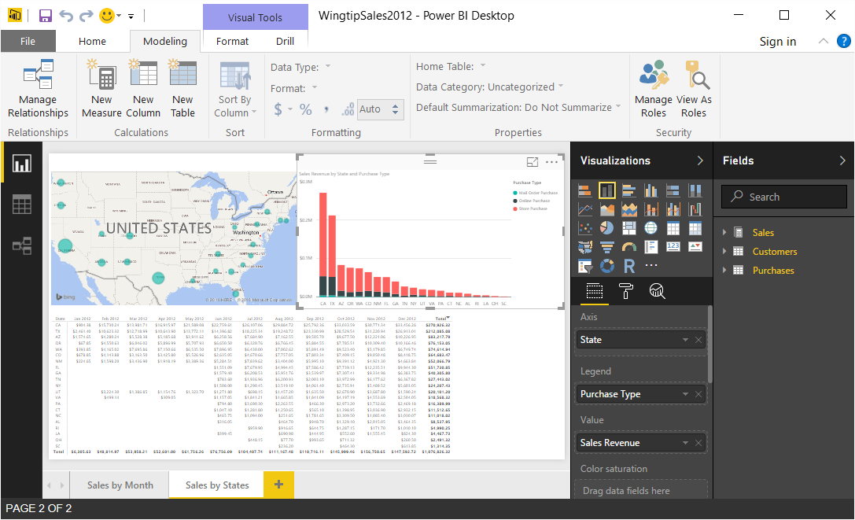
Designing Reports
Report View is used to design reports
You design reports by adding visuals & configuring them
Report design is very similar to experience in browser
Notes:
Report View in Power BI Desktop is used to design reports. The Power BI Desktop experience for designing reports is very similar to the experience in the browser when designing reports in the Power BI service.
Designing a new report is a process that involves adding new visuals and then configuring their properties. You have many different types of visuals to choose from when designing a report. You might also consider adding additional pages to your reports to you can show more information and insights.

Slide 31
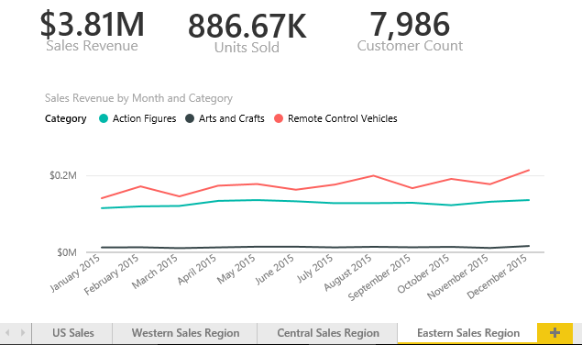
Reports and Pages
Reports contain one or more pages
A report can be designed with a single page
A report can be designed with many pages
Tabbed navigation located at bottom of report view
Each report is associated with exactly one dataset
Notes:
A report contains a collection of one or more pages. Simple report might contain just a single page while a more complicated report can contain 10 pages or more. It’s up to you to decide how many pages you want to add to each report you create.
Each report displays a tabbed navigation menu at the bottom. This provides the means to navigate between pages in a multipage page report. This menu also supplies a button with a plus (+) sign on the right which makes it possible to add new pages when a report is in design view. You can also right-click on a page in the tabbed navigation menu to rename a page or to duplicate it to clone a copy.
Keep in mind that each report is associated with exactly one underlying dataset. A report cannot see or display data from any other dataset. You should also understand that deleting a dataset will also delete any report that is based on that dataset.

Slide 32

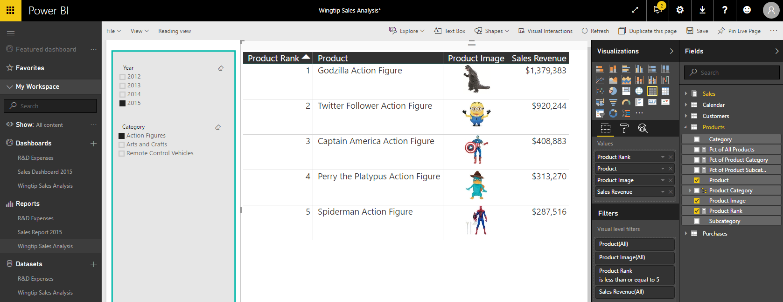
Report Authoring
Report initially opens in reading view
Click Edit report to switch to edit mode
Report design tools appear on right side of page
Notes:
Reports can be viewed in Reading view or in Edit view. When you first navigate to a report, it is initially displayed in reading view which means you cannot edit the report. However, you can click the Edit report button in the toolbar to move over into edit view whenever you need to edit a report.
When you switch a report from reading view to edit view, a set of report editing tools appear on the right side of the page. These tools such as the Visualizations pane and the Fields list make it possible to design reports by adding new visuals and configuring their properties.

Slide 33
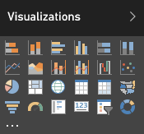
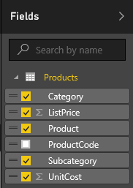
Visuals (aka Visualizations)
Reports are designed using visual (aka visualizations)
Each visuals is based on an underlying visualization type
Visualization type can be changed using Visualizations pane
Visuals creating by using fields from tables inside Fields list
Notes:
Pages within a report are designed by adding elements known as visuals. Note that Microsoft documentation uses the term “visual” and the term “visualization” interchangeably. In other words, there is no difference between a visual and a visualization. You sound a bit smarter when you use the term “visualization”, but it’s faster to say “visual” because the word only contain three syllables instead of six.
Each visual is based on an underlying visualization type. The set of visualization types available to you when designing a report are displayed in the Visualizations pane. Power BI defines a set of built-in visualization types which always appear in the Visualizations pane. One especially appealing aspect of the Power BI platform is that the set of available visualization types is extensible by adding custom visuals which you will learn about in module 6 of this training course.
When working with visuals while designing a report, you will often interact with the Fields list on the right side of the Power BI service application window. The Fields list displays all the tables and fields from the dataset associated with the current report. The Fields list is what makes it possible to associated one or more fields with a visual to populate it with data.

Slide 34
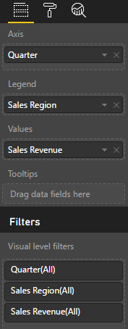
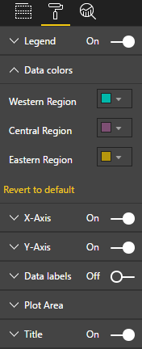
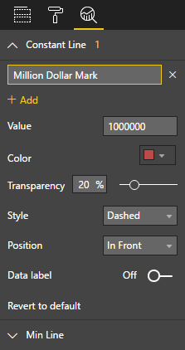
Editing Visual Properties
Visual properties modified using three property panes
Visual properties vary greatly depending on type of visualization
Fields Pane
Format Pane
Analytics Pane
Notes:
When you are working with the Power BI report editor in the browser, the properties of a visual can be modified using three different property panes on the right side of the Power BI service application windows. These three panes include the Fields pane, the Format pane and the Analytics pane. The screenshot in the slide above show where to click to activate each of these panes.
The Fields pane contains wells where you add fields from the tables of the dataset associated with the current report. The types of wells will vary greatly between different types of visualizations. For example, a line chart visual will contain wells such as Axis, Legend and Values. A map visual will contain wells such as Location, Legend and Size. A table visual only contains a single well for fields named Values.
The Format pane contains properties which affect the visual’s display characteristics such as color, font size and whether the visual will have a border.
The Analytics pane is a new comer as it was just added to the Power BI platform with the August 2016 updates. Currently, only a handful of visuals contain properties which is displayed in the Analytics pane. The purpose of the Analytics pane is to enhance a visual with analytical elements such as trend lines and constant lines.

Slide 35
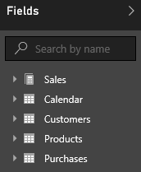
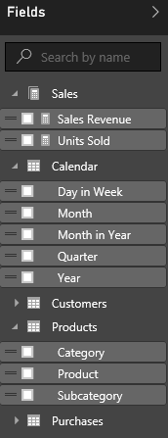
Report and Datasets
Each report is based on an underlying dataset
Fields list in report designer shows tables and fields
Report author sees tables & fields as dataset consumer
Notes:
As you know, each report is based on an underlying dataset. The Fields list displays the tables and fields from the dataset that is associated with the current report. When you begin to design report, the Fields list makes it possible to add fields into the wells inside the Fields pane for specific visuals so they can be populated with data.
When you are using the browser to edit a report, it is important to understand that you are only a dataset consumer. You have no ability to actually edit the underlying dataset. The next lecture of this training course will introduce you to a essential tool named Power BI Desktop. When you begin using Power BI Desktop, you will be able to begin editing and designing datasets with a powerful set of data modeling tools.

Slide 36
Designing a Report in Power BI Desktop

Slide 37
Summary
What Is Power BI?
Getting Started with Power BI Desktop
Creating Queries in Power BI Desktop
Modeling Data in Power BI Desktop
Designing Reports in Power BI Desktop

